Slide 1
Chapter 2: Intro to Relational Model
Notes:
‹#›

Slide 2
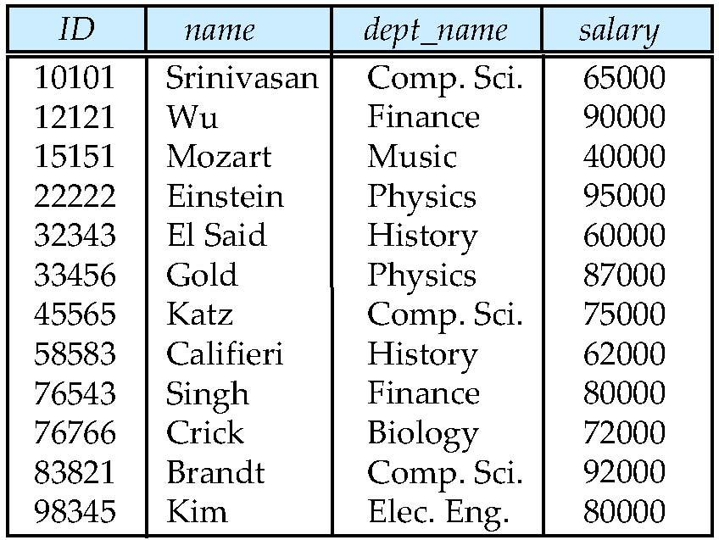
Example of a Relation
Attributes
(or columns)
Tuples
(or rows)
Shows a relationship among a set of values
Table/Relation
A collection of such relationships
Attribute Values
Notes:
‹#›

Slide 3
Relation Schema
Relation
Introduced by Dr. E.F. (“Ted”) Codd in 1970… based on set theory
Collection of relation schemas prepares a whole database
Relation Schema describes
A blueprint of a database that outlines the way data is organized into tables
Structure and constraints of data representing in a particular domain
Does not contain any type of data
Each tuple is divided into fields called Domains
Notes:
‹#›

Slide 4
Relation Schema and Instance
Relation Schema
A₁, A₂, …, A_{n} are attributes
R = (A₁, A₂, …, A_{n} ) is a relation schema
Example:
instructor = (ID, name, dept_name, salary)
Formally, given sets D₁, D₂, …. D_{n} a relation r is a subset of D₁ x D₂ x … x D_{n} Thus, a relation is a set of n-tuples (a₁, a₂, …, a_{n}) where each a_{i} ∈ D_{i}
Relation Instance
The current values of a relation are specified by a table
An element t of r is a tuple, represented by a row in a table
Notes:
‹#›

Slide 5
Attribute Types
Domain of the attribute
The set of allowed values for each attribute
Attribute values are (normally) required to be atomic; that is, indivisible
e.g. 1) For the instructor phone field is used, If the instructor
Has one phone, single value in a field
Atomic
Have series of phones, multiple values in a field separated by delimiter (comma/space)
Nonatomic (as sub part is useful)
e.g. 2) Phone is having country + state code + number
Atomic / NonAtomic
Application dependent
If all together as a one number, then Atomic
If subparts to treat separately, then NonAtomic
Notes:
‹#›

Slide 6
Attribute Types
Domain of the attribute
The special value null is a member of every domain
Can be utilized if the value is unknown or does not exist
e.g. If the instructor does not have a phone
Notes:
‹#›

Slide 7
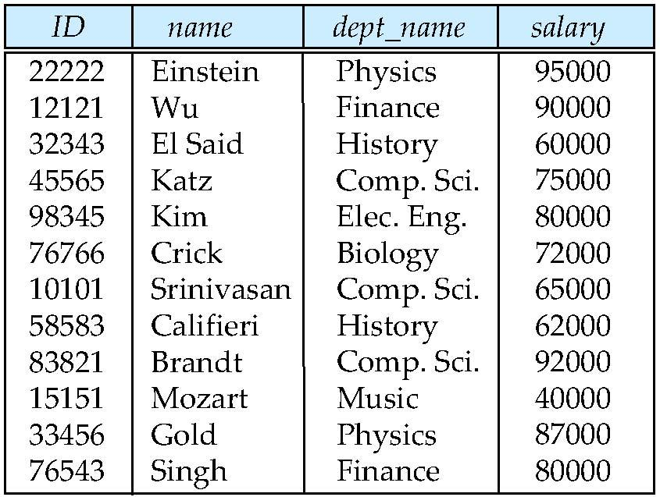
Relations are Ordered or Unordered?
Order of tuples is irrelevant (tuples may be stored in an arbitrary order)
Example: instructor relation with unordered tuples
Until explicitly asked….
Notes:
‹#›

Slide 8
Database
A database consists of multiple relations
Information about an University is broken up into parts
instructor student advisor
Design: univ (instructor Id, name, dept_name, salary, student_Id, ..)
Results in Bad Database design
Repetition of information (e.g., two students have the same instructor)
The need for null values (e.g., represent an student with no advisor)
Normalization theory deals with how to design “good” relational schemas
Notes:
‹#›

Slide 9
Keys
Used to locate data uniquely
Can be of
Single Attribute
More than one attribute
Types
Superkey
Candidate key
Primary key
Foreign key
Notes:
‹#›

Slide 10
Keys
Super key
Set of one or more attributes
K is a superkey of R if values for K are sufficient to identify a unique tuple of each possible relation r(R), where K ⊆ R
Example: {ID} and {ID, name} are both superkeys of instructor
Candidate key
Superkey K is a candidate key if K is minimal subset of super key
Example: {ID} is a candidate key for Instructor
{ID, name} is NOT a candidate key as subset of ID can uniquely identify all tuples
Notes:
‹#›
Proper Subset: If A is a subset of B and A is not equal to B then A is a proper subset of B

Slide 11
Keys
Primary key
Helps to uniquely identify the tuple
Only one primary key per table is permitted
One of the candidate keys is selected as the primary key
Care 1: The name of person is not to considered as primary key as many people with the same name may exist
Care 2: Choose such that its attribute values are never or very rarely changed, address cannot be considered as primary key as it can be changed
It is a super key also. BUT, NOT ALL THE SUPER KEYS ARE PRIMARY KEY
All the candidate keys except primary key are called alternate keys
Notes:
‹#›
Proper Subset: If A is a subset of B and A is not equal to B then A is a proper subset of B

Slide 12
Keys
Example: Employee (EmpID, EmpName, DOB, Gender, Dept_No)
Some Super keys:
EmpID
EmpID + EmpName (Redundant attribute (EmpName) permitted )
EmpID + DOB, EmpID + DOB + Gender, EmpID + Dept_No, EmpName + DOB, EmpName + DOB + Gender,……
Some Candidate keys:
EmpID
EmpName + DOB
EmpName +Dept_No
DOB + Gender
Are minimal super keys
If you divide them further, they lose the property of a key.Dept_No alone cannot uniquely identify all the tuples

Slide 13
Keys
Foreign key constraint
Value in one relation must appear in another
The relation r1 includes among its attributes the primary key of an another relation r2 (attribute x)
This attribute x is called as foreign key from r1, referencing r2
Referencing relation
The relation r1 is called referencing relation of the foreign key dependency
Referenced relation
The relation r2 is called referenced relation of the foreign key
Example: Dept_name is foreign key from instructor
In instructor is a foreign key from instructor
In department is the primary key of department
Ensures consistency, parent child relationship (To have a parent record for every child)
Need not always refer to primary keys, it can be attributes with unique value
Notes:
‹#›

Slide 14
Relax
A _________ key is a minimal super key.
A key which is a set of one or more columns that can identify a record uniquely is called _________ key.
Student (SID, FNAME, LNAME, COURSEID)
Super Keys ?
Candidate Keys ?
Primary Key ?
Foreign Key ?
Staff (StfID, StfNAME, StfPhone, StfState, StfAge)
Super Keys ?
Candidate Keys ?
Primary Key ?
Foreign Key ?

Slide 15
Relax
A _________ key is a minimal super key.
A key which is a set of one or more columns that can identify a record uniquely is called _________ key.
Student (SID, FNAME, LNAME, COURSEID)
Super Keys ?, 2. Primary Key ? 3. Foreign Key ?
Staff (StfID, StfNAME, StfPhone, StfState, StfAge)
Super Keys ?, 2. Primary Key ? 3. Foreign Key ?
Differentiate among Candidate Key and Primary Key
1: Candidate key
2: Super key
3: 1: a) SID, b) FNAME + LNAME
3: 3: SID
3: 4: COURSEID
4. 1: a) StfID, b) StfPhone
4. 3: StfID (StfPhone may change)
4. 4: No foreign key

Slide 16
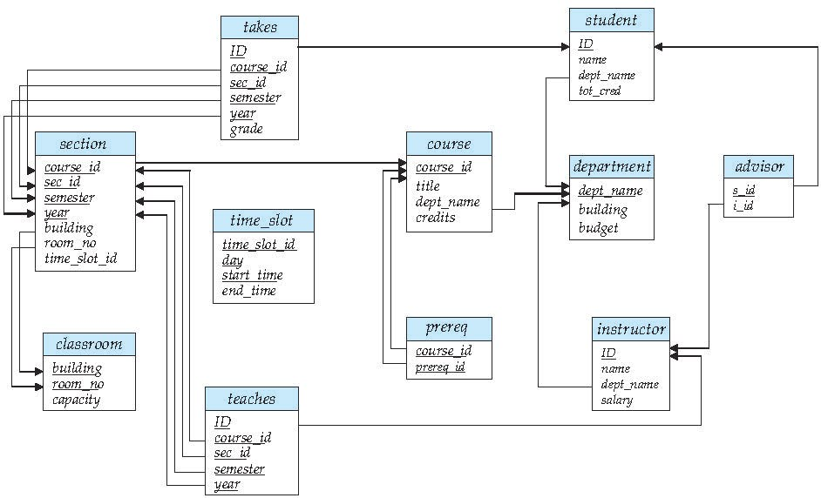
Schema Diagram for University Database
Primary Key
Primary Key
Foreign Key

Slide 17
Relational Query Languages
These query languages are concise and formal
Lack of the “syntactic sugar” of commercial languages
But they illustrate the fundamental techniques for extracting data from the database
Procedural vs. non-procedural
Relational algebra
Procedural language consists of a set of operations that take one or two relations as input and produce a new relation as their result
Tuple relational calculus
Non Procedural language uses predicate logic to define the result desired without giving any specific algebraic procedure for obtaining that result
Domain relational calculus
Non Procedural language uses domain variables that take on values from an attributes domain, rather than values for an entire tuple
Notes:
‹#›

Slide 18
Relational Operations
All procedural query languages provide a set of operations that can be applied to either a single relation or a pair of relations
These operations result in a single relation
e.g. Selection of tuples, selection of attributes, join, cartesian product, union, intersection, difference
Detail in Ch 6. Relational Algebra

Slide 19
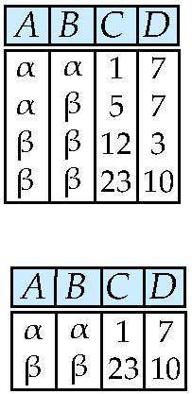
Selection of tuples
Relation r
Select tuples with A=B and D > 5
σ _{A=B and D > 5} (r)
Notes:
‹#›

Slide 20
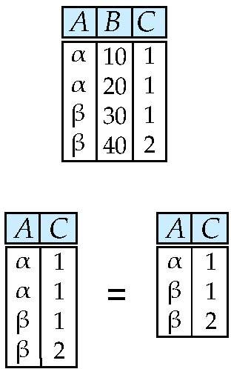
Selection of Columns (Attributes)
Relation r:
Select A and C
Projection
Π _{A, C} (r)
Notes:
‹#›

Slide 21
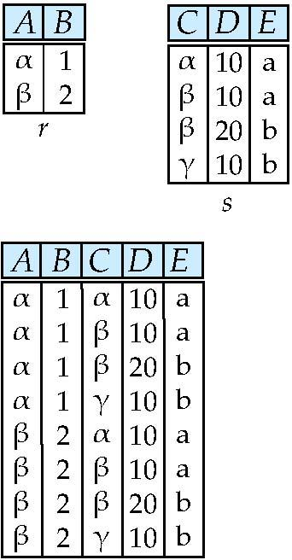
Joining two relations – Cartesian Product
Relations r, s:
r x s:
Notes:
‹#›

Slide 22
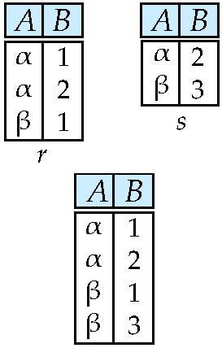
Union of two relations
Relations r, s:
r ∪ s:
Notes:
‹#›

Slide 23
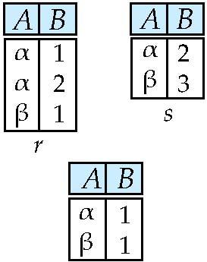
Set difference of two relations
Relations r, s:
r – s:
Notes:
‹#›

Slide 24
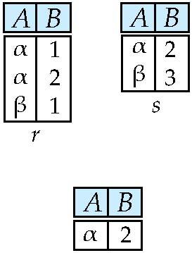
Set Intersection of two relations
Relation r, s:
r ∩ s
Notes:
‹#›

Slide 25
Joining two relations – Natural Join
Let r and s be relations on schemas R and S respectively. Then, the “natural join” of relations R and S is a relation on schema R ∪ S obtained as follows:
Consider each pair of tuples t_{r} from r and t_{s} from s.
If t_{r} and t_{s} have the same value on each of the attributes in R ∩ S, add a tuple t to the result, where
t has the same value as t_{r} on r
t has the same value as t_{s} on s
Notes:
‹#›

Slide 26
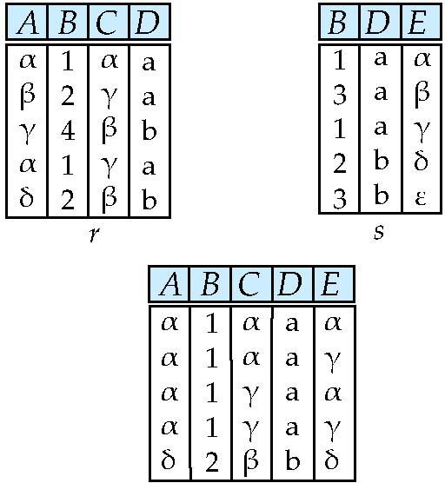
Natural Join Example
Relations r, s:
Natural Join
r s
Notes:
‹#›

Slide 27
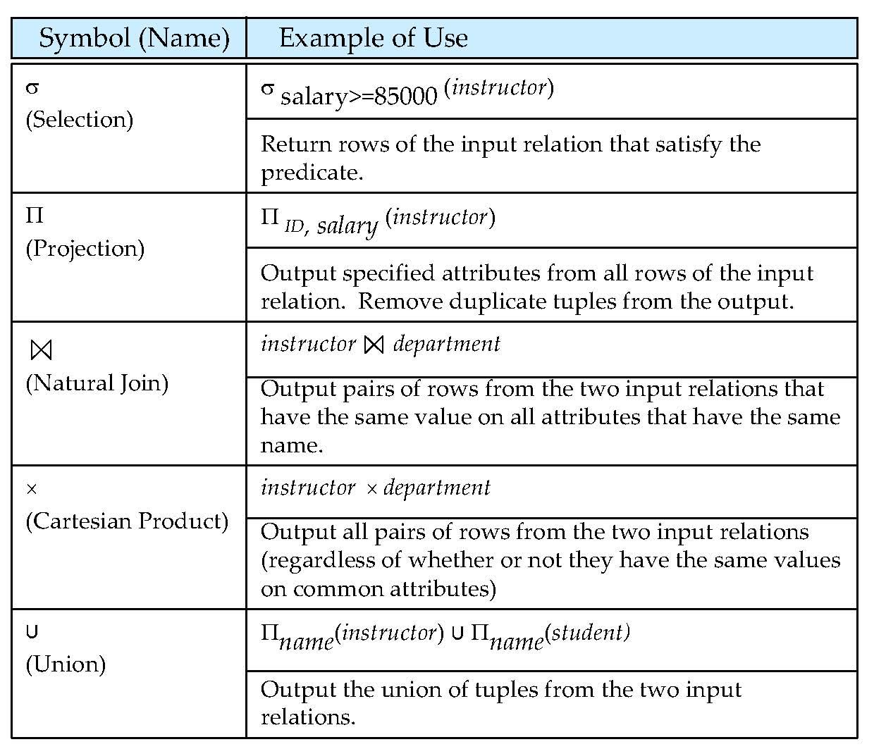
Figure 2.1
Notes:
‹#›

Slide 28
Tutorial Questions
Give example of natural join.
Write the maximum number of columns allowed per table in oracle.
Write the maximum number of rows allowed per table in oracle.
Write the maximum number of tables allowed per database in oracle.

Slide 29
End of Chapter 2 Chapter 3 SQL
Notes:
‹#›

Slide 30
Item | Type of Limit | Limit Value
Columns | Per table | 1000 columns maximum
Constraints | Maximum per column | Unlimited
Rows | Maximum number per table | Unlimited
Tables | Maximum per database | Unlimited

